Slide 1

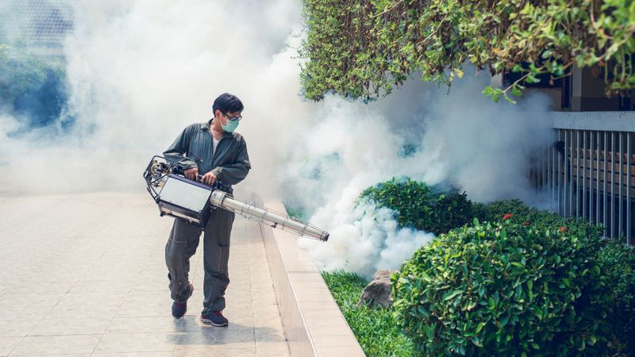
BLACKOUT PEST CONTROL SERVICES LLP

Slide 2
About Company
At Blackout Pest Control Services LLP, we have a team of highly trained and experienced professionals for more than 5 years who are well aware of pest’s lifecycle. And we have the knowledge to solve every type of pest problem. With our vast knowledge in pest control, we offer services for all types of residential and commercial premises all around Mumbai. Our aim is to provide the best Pest management service to society in which we offer the best professional and safe manner with budget-friendly solutions. Our team is trained technically to provide the best solution to every type of pest control and make customers’ house, Office , Factory, Restaurant Etc. completely pest-free. We are a company with diverse skills and talents.

Slide 3
Vision
Our vision is to be a superior service company that everyone trusts. By maintaining a high level of service, we will have the opportunity for growth and therefore, the ability to enrich the lives of our team members and give back to the communities in which we serve.

Slide 4
Mission
Our mission is to provide high-quality pest control services at competitive prices using the newest technology and training to create exceptional value for our customers.

Slide 5
Core Value
. Safety
The Safety of our employee, customer and the environment are our First priority.
. Integrity
We build trust by always doing things the "right way".
. Team Work
We work together to turn our goals into accomplishments.
. Accountability
We are individually responsible for our results.
. Customer Service
We show our appreciation for our customers through our actions.
. Professionalism
You can except highest level of professionalism from all Pyramid Pest Control Services employee at all time.

Slide 6
Services
RESIDENTIAL PEST CONTROL
COMMERCIAL PEST CONTROL
BED BUG CONTROL
COCKROACH CONTROL
MOSQUITO CONTROL
RODENT CONTROL
SPIDER CONTROL
WOOD BORER CONTROL
TERMITE INSPECTION

Slide 7












Business Sector

Slide 8

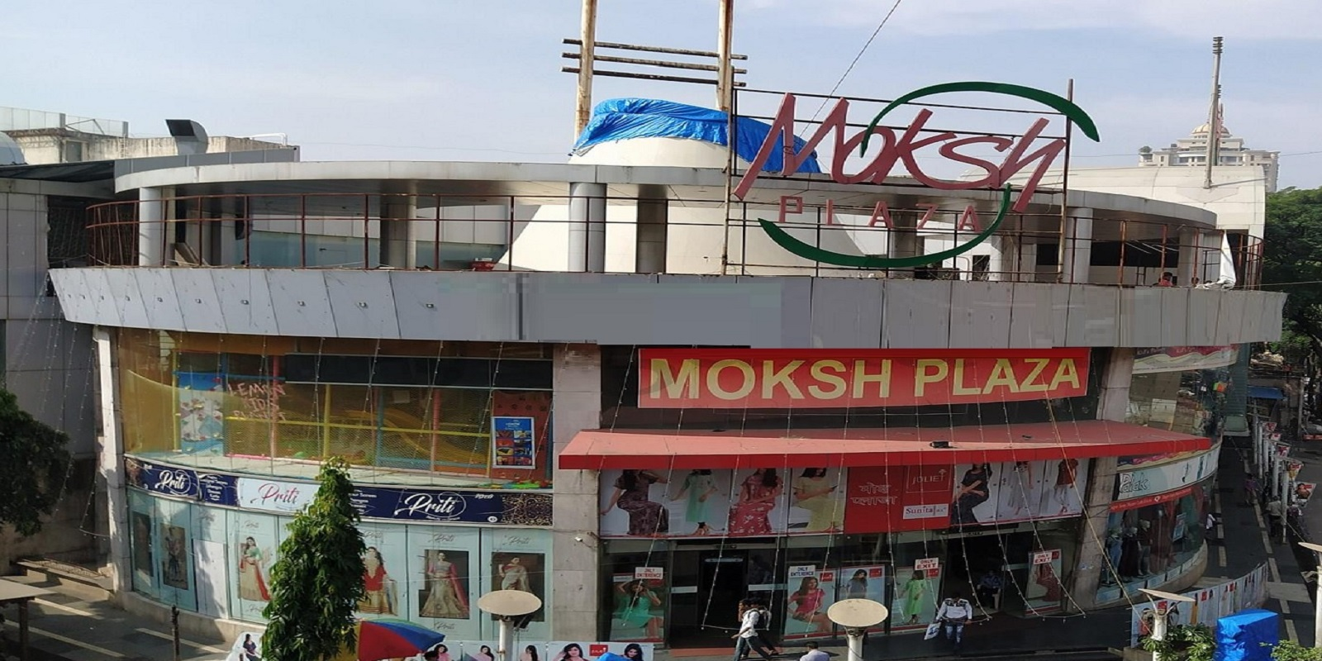

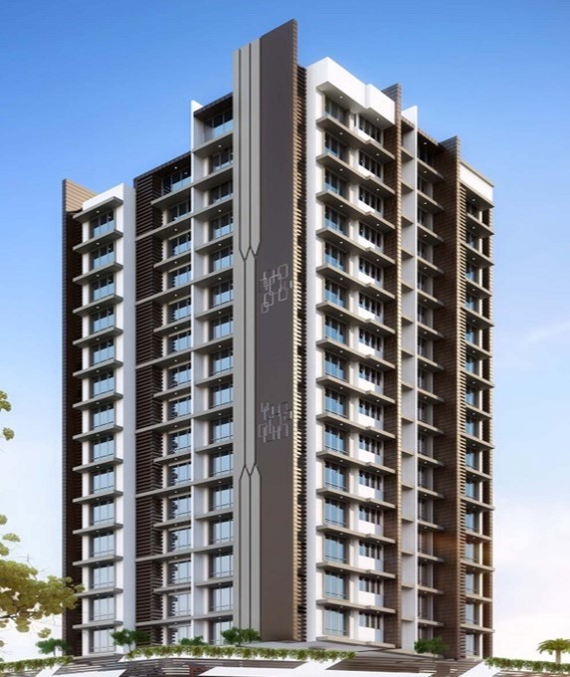
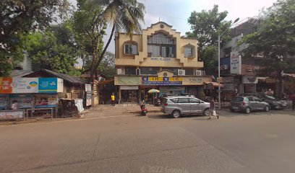







Client
REGENT GALAXY CO-OPERATIVE HOUSING SOCIETY LTD.
HEMU CLASSIC CO- OPERATIVE HOUSING SOCIETY LTD.
SHREE GANESH CO-OPERATIVE HOUSING SOCIETY LTD.
MOKSH PLAZA PREMISES CO-OPERATIVE SOCIETY LTD.
R.K. CHOKHANI & CO. ( CA )
ROYALLINE RESOURCES LIMITED.
AJAY ARVINDBHAI KHATRI.
CHANDRESH SHOPPING ARCADE CO-OP HSG.SOC. LTD
CAFÉ VILLE VILLA.
DZYRIS FROZEN FOODS PRIVATE LIMITED.
UNCLE’S KITCHEN.
HOTEL ASHIRWAD.
HETTICH INDIA PVT LTD.
KANCH SALON & ACADEMY.
SALT N PEPPER RESTAURANT & BAR.
KALYANI FAMILY RESTO BAR

Slide 9
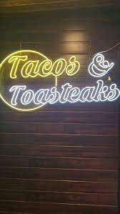





Client
Chill chilly Food Hub
Tacos & toasteaks
Dimsum Wū
Hotel Mayura
Mumbai Foods Factory
M/s VPV & CO
M/s Hotel Airport Annex
M/s Fire & Ice Restaurant
GOLDEN DELUX BAKERY
Dirty Martini - Kitchen & Bar
La Vida Restaurant
Cu Ba Restaurant
H H SHIPPING AGENCY PRIVATE LIMITED
DEVA'S JUNCTION FAMILY RESTAURANT

Slide 10









Client
Tishyas Bridal Studio
M/S AIM CARGO EXPRESS
M/s Rice Bowl
M/s Food inn Royal
M/s Barrel café
M/s Global Homeopathy
M/s Sanjeev kanchan and Co.
M/s farm view family restaurant & bar
M/s PRERANA FOODS
M/s Acapella Foods & Restaurant Pvt Ltd. ( Kokum )
M/s Smayan Spa and Salon
M/s Avalon Unisex Salon
M/s Akshay salon
M/s Magical Hands Unisex Salon and Spa
HAWA CO-OPERATIVE HOUSING SOCIETY LTD.
M/s Hotel Golden Park

Slide 11









Client
M/S S G TRAVELS
CALCIO COFFEE PRIVATE LIMITED (JLWA)
M/s The medals cake shop
M/s Lulu Salon
M/S BHAGWATI PRO-PACK TRADING LLP
M/s Glacier's cakes & more
Five Senses Theatre
M/s KAPILS SALON INDIA PRIVATE LIMITED
M/s S. K. Bakery and Sweet
M/s NANDKISHOR HOLDINGS AND CONSTRUCTION PVT LTD
M/s LEGENDARY HOSPITALITY (Richie's Bar & Eatery)
M/s CYBER MANAGERS SOFTWARE SERVICES PVT LTD (SuperMani)
M/s Palkar’s Unisex Gym and Fitness centre
M/s Total Express & Freight Forwarding
M/s Dimond Glass Work
M/s PRASHANT SHAH & CO

Slide 12










Client
M/s London Dental Clinic
M/s Royal Challenge Restaurant & Bar
M/S ABHIJEET DIES & TOOLS PVT. LTD.
M/s PARAKH HOSPITALS PRIVATE LIMITED
M/s Hotel NEST N REST
M/s Hotel Amour
M/s OBEROIIBC INDIA PVT LTD
M/S MM MITHAIWALA PVT LTD
M/s De aura kitchen and bar
M/s The Nail Palace
M/s Link View Fine Dine

Slide 13





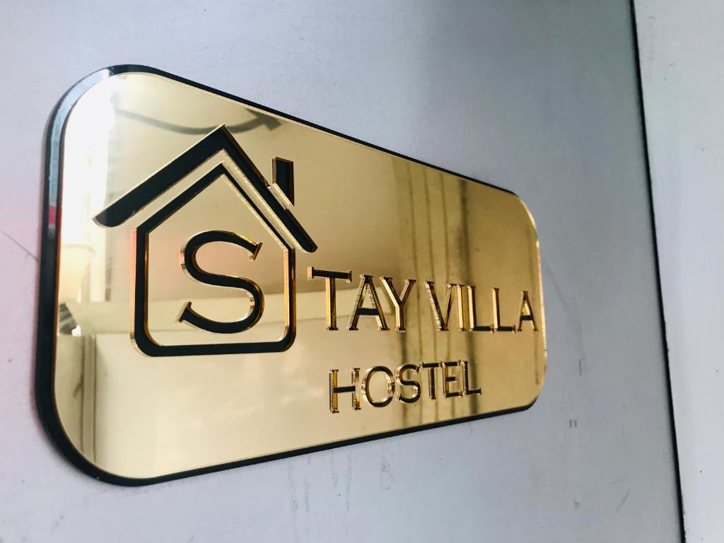


Client
M/s Jerrys Kitchen
M/S RUDRAS INTERIOR POINT PRIVATE LIMITED
M/s Roti and Grill Family Restaurant
M/s Beanstalk Asia LLP
M/s Synergy Homes
M/s Airport Inn Residency
M/s Stay Villa Hostel
M/s Seema Multispeciality Hospital
M/s SK KSHEMKARI AUTOPARTS
Suraj Sadan CHS LTD
M/s Ipromise Acadamey
M/s CAKERS AND CAKERS

Slide 14


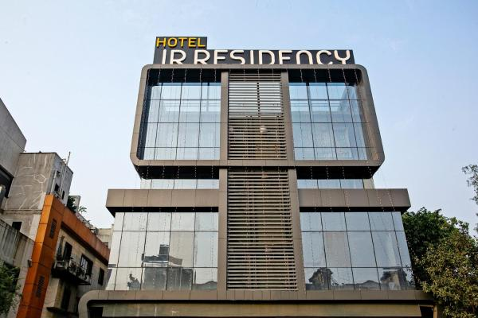


Client
M/s Kiyara Salon
M/s HOTEL CRYSTAL INN
M/s Renuja Paper Mart
Bhaveshwari Housing Society ltd
M/S Hotel JR Residency
M/S INFRASTIL GLOBAL IMPEX PRIVATE LIMITED
M/s Bule Waters International Pvt Ltd
M/s Blue Flower Spa And Wellness
M/S VINFAB ENGINEERS INDIA PRIVATE LIMITED
M/s Ayushakti Ayurved Health centre
M/s KIME CAREERS LLP

Slide 15
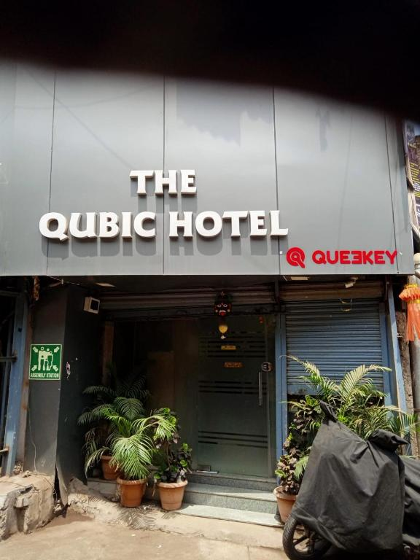



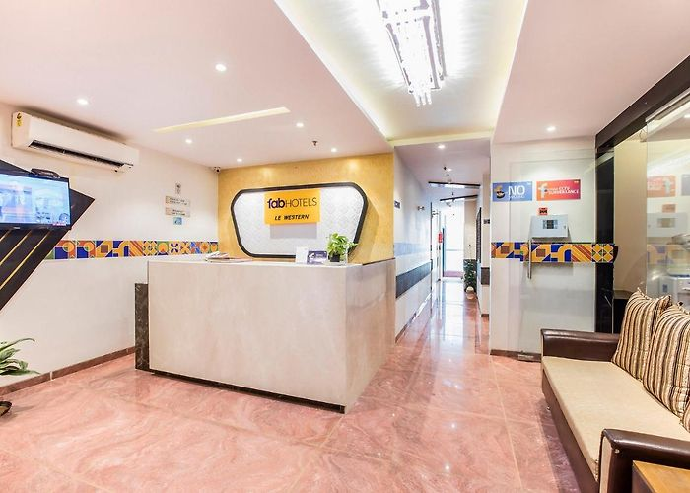
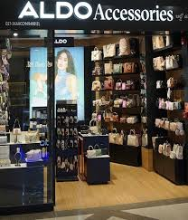
Client
M/s Gecko Worldwide
M/s Garg Dental Clinic
M/s The Qubic Hotel
M/s MULTITECH POLYMER
M/s Quest Coworks Pvt Ltd
M/s Shree Ganesh SRA CHS LTD. & Shree Vinayak SRA CHS LTD
M/s Aldo Accessories
M/s Food Swings
M/s Hotel Le-Western

Slide 16
How company works
1 Inquiry / book appointment
2 Inspection
3 Treatment
4 Follow-up

Slide 17
WHY BLACKOUT PEST CONTROL SERVICES LLP
We provide
7 days per week complete service
24/7 customer support service.
Reliable, quality, and punctual service.
Providing pest control services for many years.
Highly trained and experienced technicians
Use of advanced and natural gel treatment for cockroach and termite control
Maintaining report as per requirements
Use only chemicals and products that are verified by the Central Insecticide Board of India.

Slide 18


